Slide 1
STAGE 4 GEOGRAPHY
Landforms and Landscapes
REVISION DECK
Restyled in SPCC house style from the original Topic 2 deck (2017), keeping its photos, diagrams and sources.
Perkins (2026)
Page 1 of 39
Landforms and Landscapes | Stage 4 Geography | REVISION deck
Notes:
[Claude-added teacher note] Title slide. This deck is a restyle of the original 2017 deck for the Stage 4 Geography 'Landscapes and landforms' topic - content and case studies are from that source, restyled into SPCC house style.

Slide 2
Learning intention
We are learning how natural processes shape the Earth's landscapes, and why those landscapes matter to people.
Success criteria - I can:
• I can explain weathering, erosion, deposition and plate tectonics.
• I can describe the aesthetic, cultural and economic value of a landscape.
• I can explain how people change landscapes, using the Australian coast as an example.
Perkins (2026)
Page 2 of 39
Landforms and Landscapes | Stage 4 Geography | REVISION deck
Notes:
[Claude-added teacher note] Sits under the syllabus focus on geographical processes that shape landscapes, and the value people place on them. Worth checking this intention against the exact outcome wording in your own NSW Geography 7-10 (2024) syllabus copy before using with a class.

Slide 3
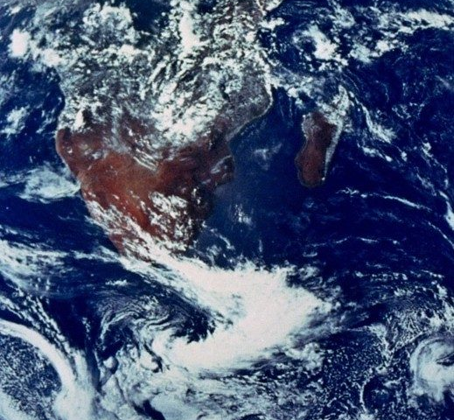
What processes and impacts are occurring to these landscapes?
• Every landscape you will revise in this deck has been shaped by natural processes over a very long time.
• As you work through each case study, keep asking: what process made this, and what does it mean for the people who live there?
Image: NASA, "The Blue Marble" (Apollo 17, 1972) - public domain.
Perkins (2026)
Page 3 of 39
Landforms and Landscapes | Stage 4 Geography | REVISION deck
Notes:
[Claude-added teacher note] Framing slide - use to activate prior knowledge before the six landscape photos. Ask students to predict the process behind each landscape before you reveal the geomorphic processes section.

Slide 4
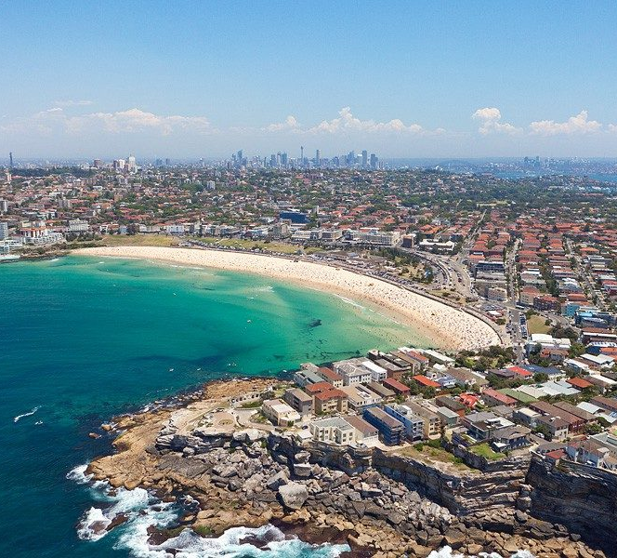
COASTLINE LANDSCAPE
Sydney, Australia
Image: original resource, source listed in references.
Perkins (2026)
Page 4 of 39
Landforms and Landscapes | Stage 4 Geography | REVISION deck
Notes:
[Claude-added teacher note] Coastline landscape (Sydney). Good anchor example - most students have direct experience of an Australian coastline.

Slide 5
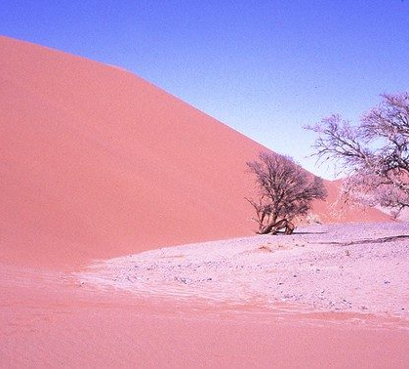
ARID LANDSCAPE
Namibia
Image: original resource, source listed in references.
Perkins (2026)
Page 5 of 39
Landforms and Landscapes | Stage 4 Geography | REVISION deck
Notes:
[Claude-added teacher note] Arid landscape (Namibia). Contrast with the coastline example - different dominant processes (wind erosion/deposition vs wave action).

Slide 6
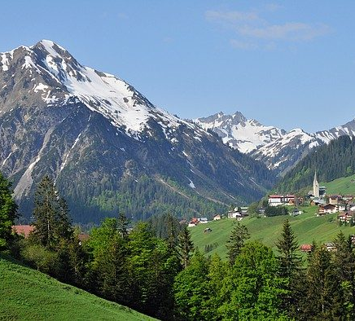
MOUNTAIN LANDSCAPE
The Alps, Switzerland
Image: original resource, source listed in references.
Perkins (2026)
Page 6 of 39
Landforms and Landscapes | Stage 4 Geography | REVISION deck
Notes:
[Claude-added teacher note] Mountain landscape (The Alps). Useful for introducing plate tectonics and altitude-driven weathering later in the deck.

Slide 7
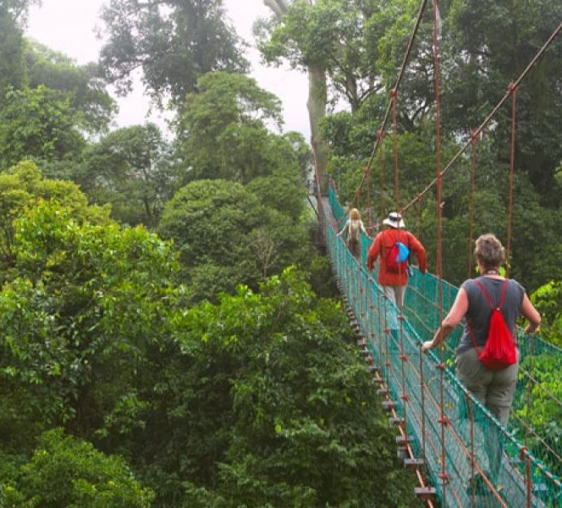
RAINFOREST LANDSCAPE
Borneo, Malaysia
Image: original resource, source listed in references.
Perkins (2026)
Page 7 of 39
Landforms and Landscapes | Stage 4 Geography | REVISION deck
Notes:
[Claude-added teacher note] Rainforest landscape (Borneo). Good opportunity to raise chemical weathering (high rainfall, humidity) if extending beyond the original deck's scope.

Slide 8
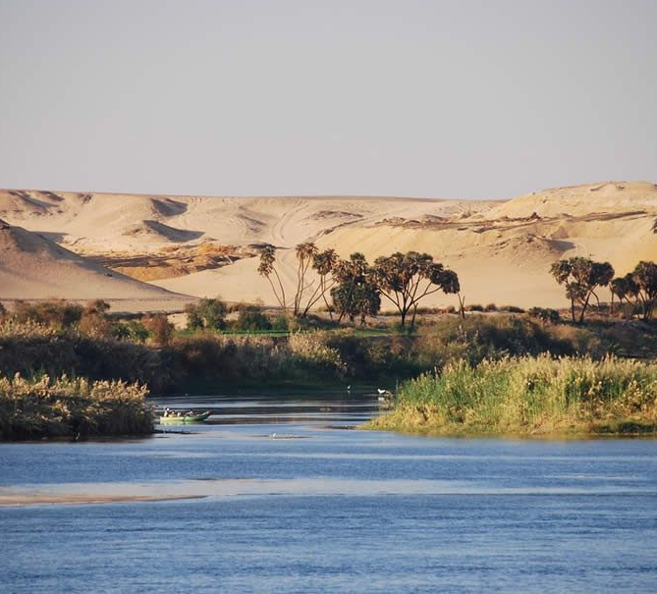
RIVERINE LANDSCAPE
The Nile, Egypt
Image: original resource, source listed in references.
Perkins (2026)
Page 8 of 39
Landforms and Landscapes | Stage 4 Geography | REVISION deck
Notes:
[Claude-added teacher note] Riverine landscape (The Nile). Links forward to the deposition and river-delta content later in the deck.

Slide 9
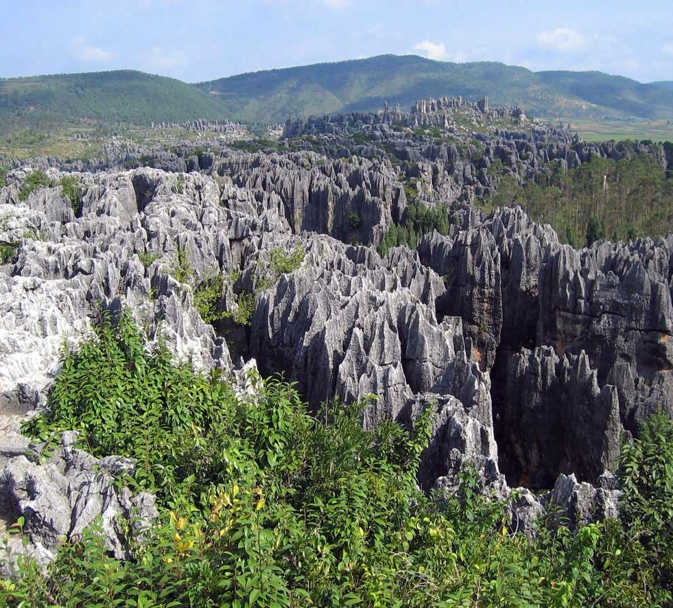
KARST LANDSCAPE
South China
Image: original resource, source listed in references.
Perkins (2026)
Page 9 of 39
Landforms and Landscapes | Stage 4 Geography | REVISION deck
Notes:
[Claude-added teacher note] Karst landscape (South China). The least familiar of the six to most students - worth a short explanation of limestone dissolution if time allows.

Slide 10
Geomorphic processes
Weathering, erosion, deposition and plate tectonics
Perkins (2026)
Page 10 of 39
Landforms and Landscapes | Stage 4 Geography | REVISION deck
Notes:
[Claude-added teacher note] Transition into the geomorphic processes content - weathering, erosion, deposition, plate tectonics.

Slide 11
The processes that create landforms
Geomorphic processes are natural processes that transform the lithosphere to create distinctive landscapes and landforms.
1
2
3
4
WEATHERING
EROSION
DEPOSITION
PLATE TECTONICS
The breakdown of rocks and sediments into smaller particles or a solution. Occurs in a range of landscapes, e.g. coastlines and mountains.
The wearing away of the earth's surface, after weathering. Affected by the actions of wind and water.
The relocation of eroded matter into a new location. Rivers and coastline landscapes have a large amount of deposition.
The movement of the major plates that make up the earth's crust, between continents and the ocean floor. Types: divergent, collision, convergent or transform.
Perkins (2026)
Page 11 of 39
Landforms and Landscapes | Stage 4 Geography | REVISION deck
Notes:
[Claude-added teacher note] Core definitions slide. These four terms recur through the rest of the deck and are a common source of mixed-up answers in exams - worth a quick check-in question here before moving on.

Slide 12
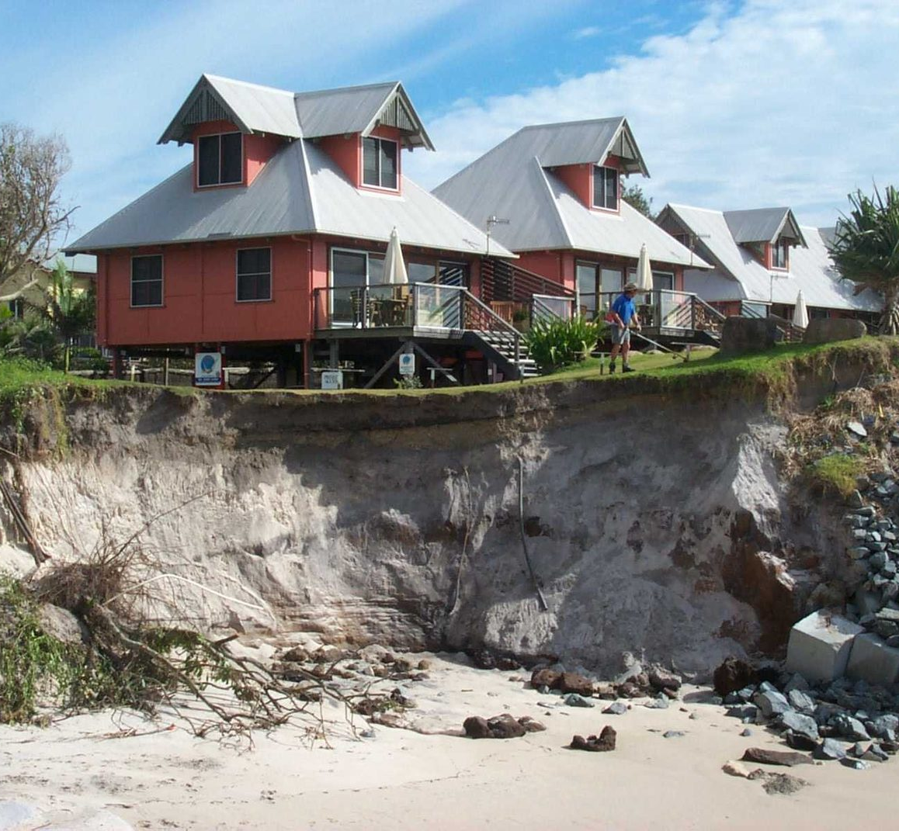
Erosion in action: a house on the edge
• This house shows what erosion looks like when it is left unmanaged.
• Wind and water have worn away the cliff underneath it over many years, and the land it once stood well back from is now gone.
• This is also a liveability and planning issue - not just a geomorphic one.
Image: original resource, source listed in references.
Perkins (2026)
Page 12 of 39
Landforms and Landscapes | Stage 4 Geography | REVISION deck
Notes:
[Claude-added teacher note] Real consequence of erosion - useful for linking geomorphic process to human/liveability impact, which comes up again in the 'changing landscapes' section.

Slide 13
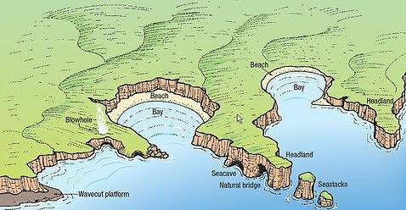
Over to you
Look at the diagram below. List the processes that are occurring on this coastline.
Diagram: features of coasts caused by erosion - original resource, source listed in references.
Think about headlands, bays, wave-cut platforms, blowholes and sea stacks.
Perkins (2026)
Page 13 of 39
Landforms and Landscapes | Stage 4 Geography | REVISION deck
Notes:
[Claude-added teacher note] Over to you task - no answer key provided in the original. Suggested answers: headland, bay, wave-cut platform, sea cave, natural bridge, sea stack, blowhole (all labelled on the diagram).

Slide 14
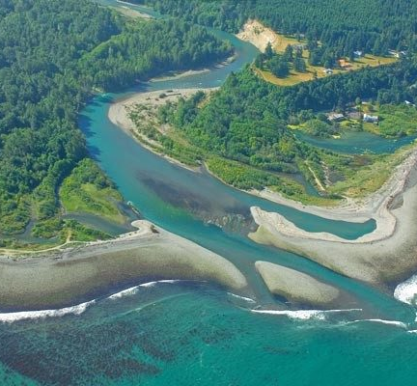
Deposition: building new land
• Deposition is the relocation of eroded matter into a new location.
• Rivers and coastline landscapes have a large amount of deposition - this river delta shows sediment building up new land where the river meets the sea.
Image: original resource, source listed in references.
Perkins (2026)
Page 14 of 39
Landforms and Landscapes | Stage 4 Geography | REVISION deck
Notes:
[Claude-added teacher note] Deposition example - pair with the erosion photo on the previous section for a clear before/after contrast.

Slide 15
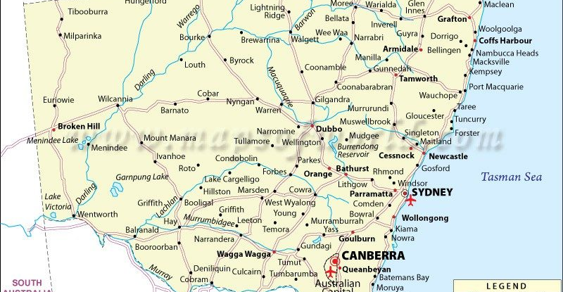
Over to you
Using Google Maps on Google Drive, make a map of the major rivers in NSW that flow to the Pacific Ocean. Your map needs a title, labels of the rivers you find, and you need to measure one river.
Map: mapsofworld.com - original resource, source listed in references.
Perkins (2026)
Page 15 of 39
Landforms and Landscapes | Stage 4 Geography | REVISION deck
Notes:
[Claude-added teacher note] Original task from the source deck - a practical, if your class has NSW Geography access to Google Drive/Maps.

Slide 16
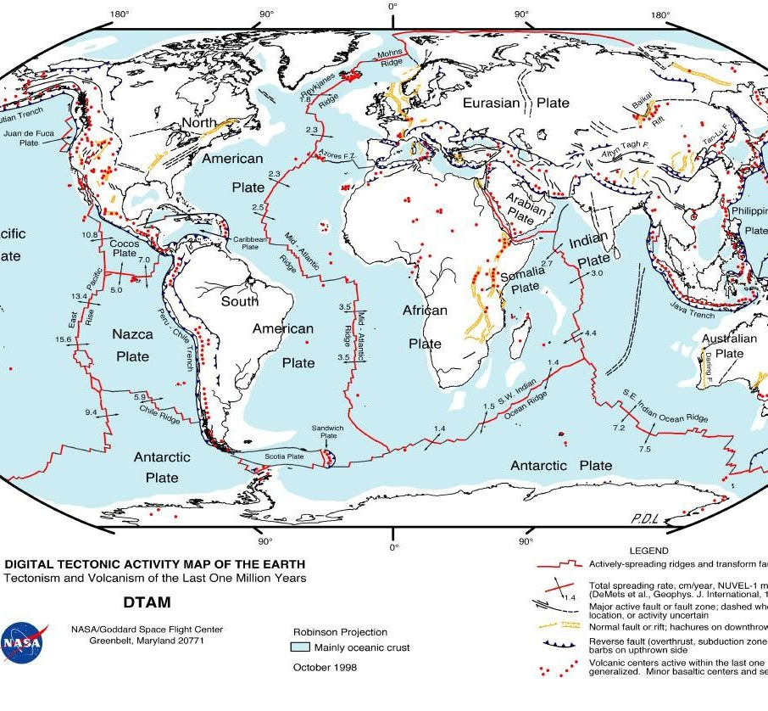
Plate tectonics
• The movement of the major plates that make up the earth's crust.
• These movements occur between continents and the ocean floor.
• Types of processes: divergent, collision, convergent or transform boundaries.
Map: NASA Goddard Space Flight Center, Digital Tectonic Activity Map of the Earth.
Perkins (2026)
Page 16 of 39
Landforms and Landscapes | Stage 4 Geography | REVISION deck
Notes:
[Claude-added teacher note] NASA tectonic map - good for a 'spot the pattern' activity (plate boundaries align with earthquake/volcano zones).

Slide 17
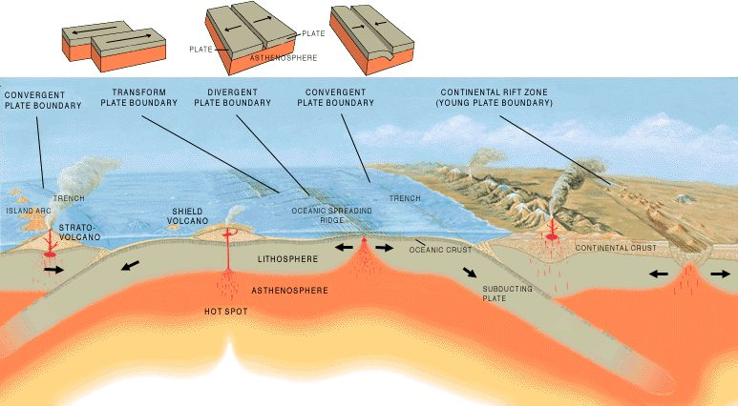
How plate boundaries move
Convergent, divergent and transform plate boundaries.
Diagram: original resource, source listed in references.
Perkins (2026)
Page 17 of 39
Landforms and Landscapes | Stage 4 Geography | REVISION deck
Notes:
[Claude-added teacher note] Use this diagram to directly contrast convergent, divergent and transform boundaries side by side.

Slide 18
Watch: landscapes shaped by weathering and erosion
Watch: Landscapes and Landforms: Coastal landscapes (ABC Education)
ABC Education, "Landscapes and Landforms: Coastal landscapes".
Notes:
[Claude-added teacher note] Real ABC Education video, verified working at time of building this deck (2026) - preview before class in case the link has moved.

Slide 19
Watch: an introduction to plate tectonics
Watch: Introduction to plate tectonics (Khan Academy)
Khan Academy, "Introduction to plate tectonics".
Notes:
[Claude-added teacher note] Real Khan Academy video, verified working at time of building this deck (2026) - preview before class in case the link has moved.

Slide 20
Aesthetic and cultural value
Why landscapes matter to culture and identity
Perkins (2026)
Page 20 of 39
Landforms and Landscapes | Stage 4 Geography | REVISION deck
Notes:
[Claude-added teacher note] Transition into aesthetic and cultural value - a good moment to ask students for their own examples before showing the slides.

Slide 21
Aesthetic and cultural value
Aesthetic value is the value placed on something due to its beauty. Cultural value is the emphasis placed on something for its importance and place in society.
1
2
3
4
BEAUTY
IDENTITY
SPIRITUAL MEANING
HERITAGE LISTING
Landscapes can be valued simply for how they look - their colours, scale and form.
Some landscapes become part of a group's sense of who they are.
Many landscapes hold deep spiritual or cultural significance for the people connected to them.
The most significant sites can be World Heritage listed to protect their value for the future.
Perkins (2026)
Page 21 of 39
Landforms and Landscapes | Stage 4 Geography | REVISION deck
Notes:
[Claude-added teacher note] Core definitions slide for this section.

Slide 22
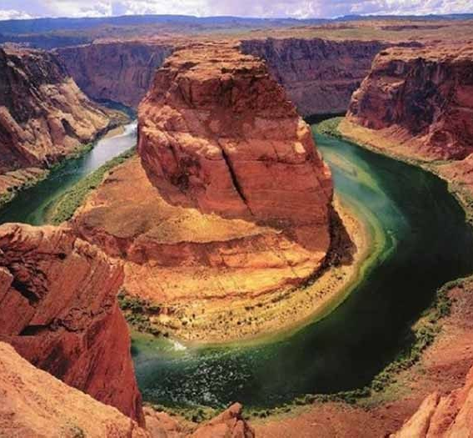
Aesthetic value: landscapes valued for their beauty
• This canyon is valued purely for its beauty - the colour of the rock, the curve of the river and the scale of the landscape draw visitors from around the world.
• Aesthetic value like this can also translate into economic value, through tourism.
Image: original resource, source listed in references.
Perkins (2026)
Page 22 of 39
Landforms and Landscapes | Stage 4 Geography | REVISION deck
Notes:
[Claude-added teacher note] Aesthetic value example - ask students what makes this landscape 'beautiful' specifically, not just that it is.

Slide 23
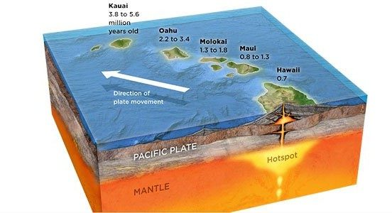
Hawaii: a landscape built by a volcanic hotspot
The Hawaiian Islands formed one at a time as the Pacific Plate moved over a fixed volcanic hotspot.
Diagram: original resource, source listed in references.
Perkins (2026)
Page 23 of 39
Landforms and Landscapes | Stage 4 Geography | REVISION deck
Notes:
[Claude-added teacher note] Hawaii hotspot diagram - useful for showing that aesthetic/cultural value and geomorphic process are often the same landscape seen two ways.

Slide 24
Find out more: Hawaii's volcanic islands
Try these searches:
• "Hawaii volcanic hotspot formation video"
• "how the Hawaiian islands were formed"
Check these sites:
• abc.net.au/education
• geoscience.gov.au
• usgs.gov
No single verified classroom video could be confirmed for this topic - search and preview before showing in class.
Notes:
[Claude-added teacher note] No verified video could be sourced for this specific topic - search live before class rather than skipping the discussion.

Slide 25
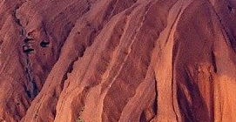
Over to you
List the locations in Australia that have aesthetic value to you.
Image: original resource, source listed in references.
Perkins (2026)
Page 25 of 39
Landforms and Landscapes | Stage 4 Geography | REVISION deck
Notes:
[Claude-added teacher note] Open task - no answer key in the original. Expect a spread of answers; a good one for class discussion/comparison.

Slide 26
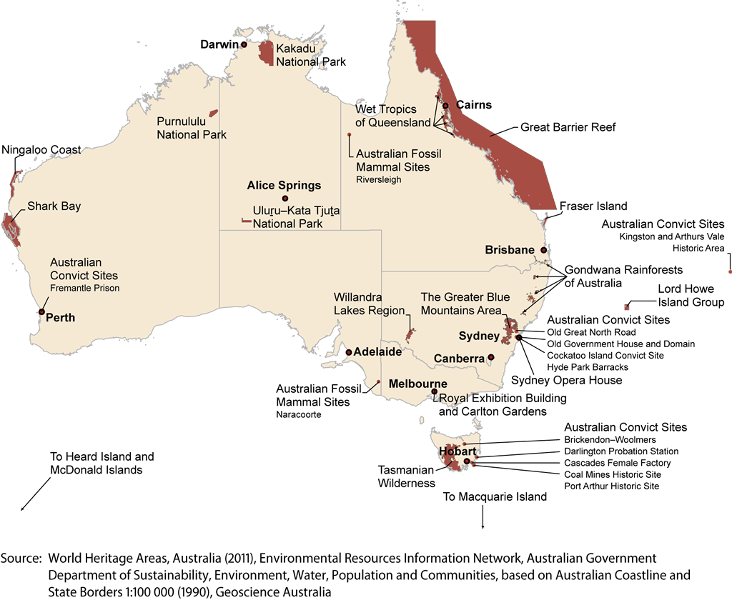
World Heritage sites of Australia
Australia's World Heritage listed sites and areas.
Source: World Heritage Areas, Australia (2011), Dept of Sustainability, Environment, Water, Population and Communities.
Perkins (2026)
Page 26 of 39
Landforms and Landscapes | Stage 4 Geography | REVISION deck
Notes:
[Claude-added teacher note] Real, sourced map (Australian Government, 2011).

Slide 27
Over to you: World Heritage sites
World Heritage Site | Aesthetic or Cultural Value | Reason
Perkins (2026)
Page 27 of 39
Landforms and Landscapes | Stage 4 Geography | REVISION deck
Notes:
[Claude-added teacher note] Table task - students pick 2 to 4 World Heritage sites from the previous slide's map and complete the table themselves.

Slide 28
Economic value of landscapes
How landscapes generate income for different people
Perkins (2026)
Page 28 of 39
Landforms and Landscapes | Stage 4 Geography | REVISION deck
Notes:
[Claude-added teacher note] Transition into economic value.

Slide 29
Place and economic value of landscapes
Some landscapes hold economic significance. This can generate revenue through art and tourism.
1
2
3
4
TOURISM
EMPLOYMENT
INVESTMENT
TRADE-OFFS
Visitors travel specifically to see famous landscapes, spending money on travel, food and accommodation.
Tourism and land-based industries create local jobs.
Economic value can fund further conservation and infrastructure.
Economic use can clash with protecting a landscape's natural or cultural value.
Perkins (2026)
Page 29 of 39
Landforms and Landscapes | Stage 4 Geography | REVISION deck
Notes:
[Claude-added teacher note] Core definitions slide for this section.

Slide 30
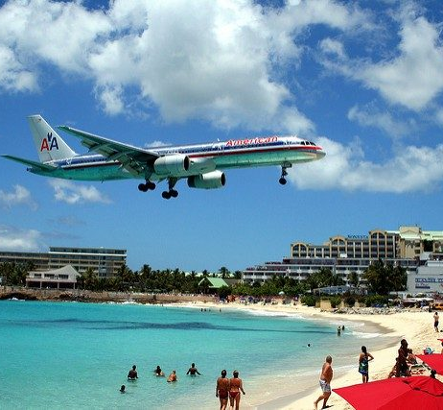
Top tourist destinations in Australia
• Australia's landscapes are a major drawcard for both international and domestic tourists.
• Coastal destinations like this one depend on the beach, the water and the surrounding landscape staying attractive and accessible.
Image: original resource, source listed in references.
Perkins (2026)
Page 30 of 39
Landforms and Landscapes | Stage 4 Geography | REVISION deck
Notes:
[Claude-added teacher note] Illustrates tourism-driven economic value - pairs well with the Uluru case study next.

Slide 31
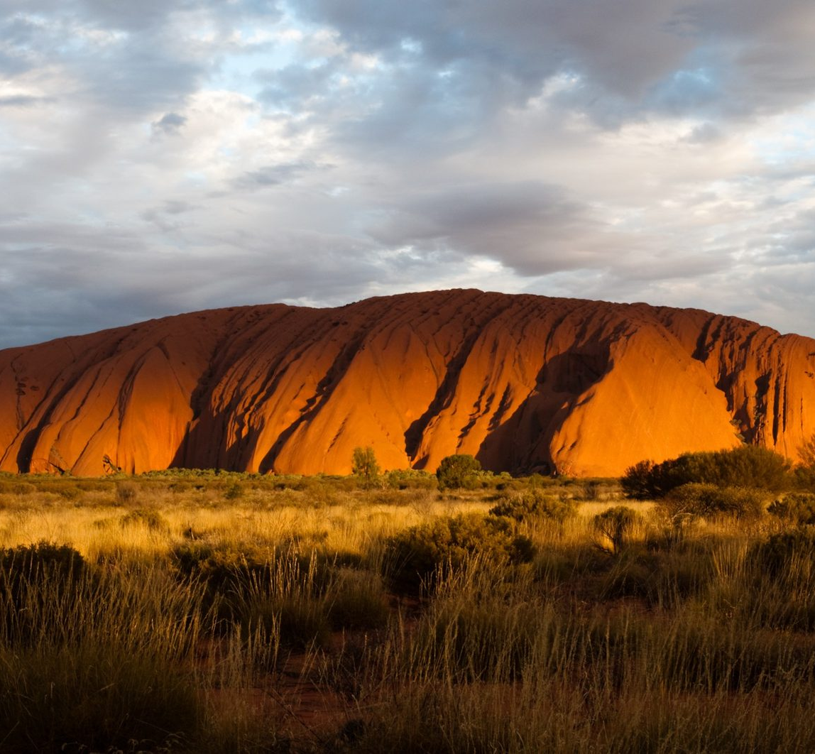
Case study: Uluru
• Uluru is a large sandstone monolith that is 348 metres high and has a circumference of 9.4 km.
• Around 400,000 people visit Uluru every year, providing a large economic boost to the Anangu people, the land's traditional owners.
• Uluru carries deep cultural and spiritual value for the Anangu as well as economic value from tourism - both matter, and the two are managed together.
Image: original resource, source listed in references.
Perkins (2026)
Page 31 of 39
Landforms and Landscapes | Stage 4 Geography | REVISION deck
Notes:
[Claude-added teacher note] Case study slide - figures (348m, 9.4km, ~400,000 visitors/year) are from the original deck and were not independently re-verified when this deck was restyled; worth a quick currency check if used in a future year.

Slide 32
Changing landscapes
How people use and change landscapes - the Australian coast
Perkins (2026)
Page 32 of 39
Landforms and Landscapes | Stage 4 Geography | REVISION deck
Notes:
[Claude-added teacher note] Transition into changing landscapes - the final content section, tying process, value and human impact together.

Slide 33
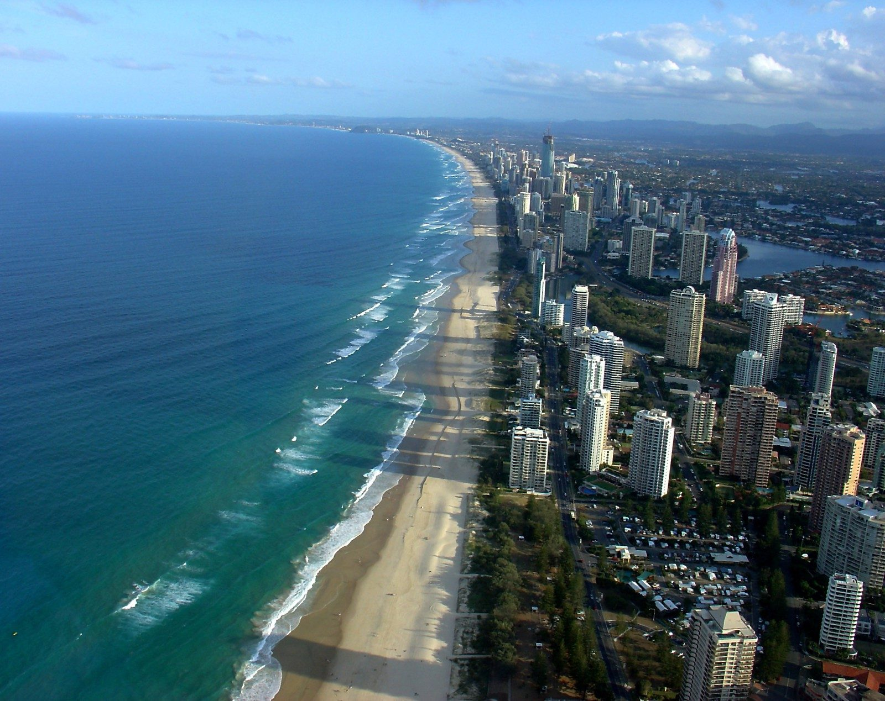
Changing landscapes in Australia
• Coastal areas are heavily changed in Australia. 80% of the population lives within 50 km of the coast.
• A clash between economic value, liveability and aesthetic value can develop as more people move to the coast.
Image: original resource, source listed in references.
Perkins (2026)
Page 33 of 39
Landforms and Landscapes | Stage 4 Geography | REVISION deck
Notes:
[Claude-added teacher note] Sets up the coastal population statistic used again on the population infographic slide.

Slide 34
Over to you
List the reasons why Australians live on the coast.
Image: original resource, source listed in references.
Think about climate, jobs, lifestyle and access to the water.
Perkins (2026)
Page 34 of 39
Landforms and Landscapes | Stage 4 Geography | REVISION deck
Notes:
[Claude-added teacher note] Open task - no answer key in the original. Expect: climate, lifestyle, jobs, access to water/recreation.

Slide 35
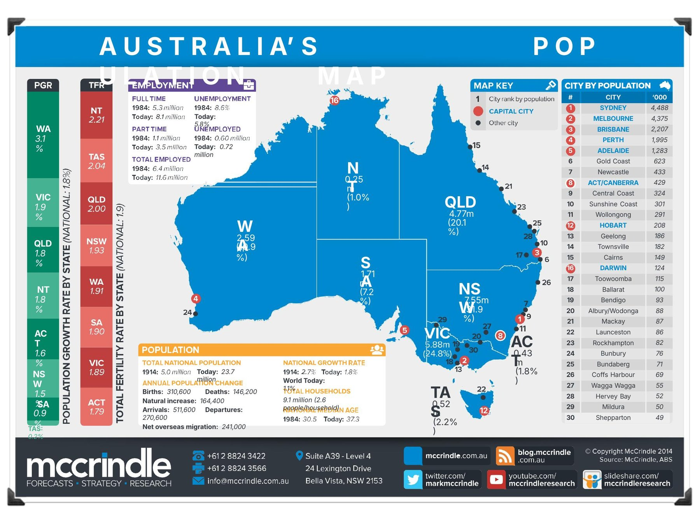
Australia's population: where people live
Most Australians live in the coastal south-east - NSW and Victoria together hold over half the population.
Source: McCrindle Research, "Australia's Population Map", based on ABS data.
Perkins (2026)
Page 35 of 39
Landforms and Landscapes | Stage 4 Geography | REVISION deck
Notes:
[Claude-added teacher note] McCrindle Research infographic, sourced from the original deck - useful for a numeracy tie-in (reading a population map).

Slide 36
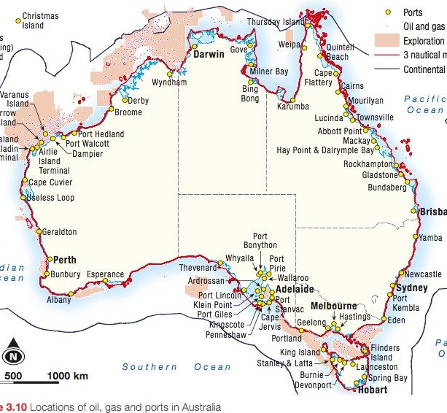
Coastal issues for Australia
• Stormwater run-off and sewage flow into rivers, the sea and wetlands, threatening recreation, human health and ecosystems.
• Pesticides, fertilisers and other chemicals are released into stormwater or sewerage systems, increasing pollution.
• Coastal native bush and habitat is lost as city margins expand along the coast in a ribbon.
• Coastal wetlands are destroyed, leading to a loss of nursery grounds for fisheries.
• Toxic waste can be released from old coastal industrial sites or rubbish dumps during redevelopment.
Text and map (Source 3.10): as featured in the original source deck - original textbook not independently verified.
Perkins (2026)
Page 36 of 39
Landforms and Landscapes | Stage 4 Geography | REVISION deck
Notes:
[Claude-added teacher note] Text and map are from the original source deck (captioned 'Source 3.10' there); the original textbook was not identified or independently verified when this deck was restyled - check before citing the figure/map source by name with a class.

Slide 37
References - sources used in this deck
Shipp, A. Landforms and Landscapes (Year 7 Geography, Topic 2) - original source deck for this resource
https://www.slideshare.net/adeshipp/landforms-and-landscapes
NASA. The Blue Marble (Apollo 17, 1972)
https://visibleearth.nasa.gov/images/55418/blue-marble-the-earth-seen-from-apollo-17
NASA Goddard Space Flight Center. Digital Tectonic Activity Map of the Earth
https://denali.gsfc.nasa.gov/dtam/
ABC Education. Landscapes and Landforms: Coastal landscapes
https://www.abc.net.au/education/landscapes-and-landforms-coastal-landscapes/102317076
Khan Academy. Introduction to plate tectonics
https://www.khanacademy.org/science/middle-school-earth-and-space-science/x87d03b443efbea0a:the-geosphere/x87d03b443efbea0a:plate-tectonics/v/introduction-to-plate-tectonics
Australian Government. World Heritage Areas, Australia (2011), Dept of Sustainability, Environment, Water, Population and Communities
https://www.environment.gov.au/heritage/places/world-heritage-list
McCrindle Research. Australia's Population Map, based on ABS data
https://mccrindle.com.au
Mapsofworld.com. New South Wales map
https://www.mapsofworld.com
Perkins (2026)
Page 37 of 39
Landforms and Landscapes | Stage 4 Geography | REVISION deck
Notes:
[Claude-added teacher note] Full source list for every photo, diagram, video and statistic used in this deck - share this slide if a student or colleague asks where something came from.

